Slide 1
…updates…

Slide 2



New Server Virtualization Paradigm
ENTERPRISE APPLICATIONS
Applications requiring fraction
of the physical server resources
HIGH PERFORMANCE COMPUTING
Applications requiring superset
of the physical server resources
Existing: Partitioning
New: Aggregation
Virtual Machines
Virtual Machine
App
App
App
App
OS
OS
OS
OS
Hypervisor or VMM
Hypervisor or VMM
Hypervisor or VMM
Hypervisor or VMM
Hypervisor or VMM

Slide 3
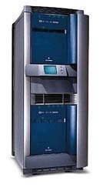
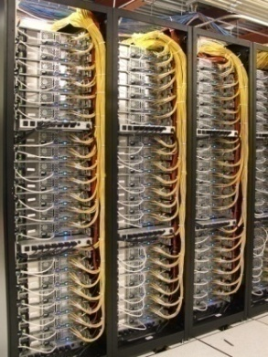
Existing HPC Deployment Models
Applications requiring superset
of the physical server resources
Scale-Up
Scale-Out
Fit the hardware to the problem size
Break the problem to fit the hardware

Slide 4
Existing HPC Deployment Models
PROS AND CONS
Scale-Up
Scale-Out
Fit the hardware to the problem size
Break the problem to fit the hardware
+
-
Simplified IT infrastructure
  Simple and flexible programming
  Single system to manage
  Consolidated I/O
High installation & management cost
  Complex parallel programming
  Multiple operating systems
  Cluster file systems, etc.
-
+
Proprietary hardware design
  High cost
  Architecture lock-in
Leverages industry standard servers
  Low cost
  Open architecture

Slide 5
Existing HPC Deployment Models
PROS AND CONS
Scale-Up
Scale-Out
Aggregation
+
Simplified IT infrastructure
  Simple and flexible programming
  Single system to manage
  Consolidated I/O
Virtual Machine
App
OS
+
Leverages industry standard servers
  Low cost
  Open architecture
Hypervisor or VMM
Hypervisor or VMM
Hypervisor or VMM
Hypervisor or VMM

Slide 6


vSMP Foundation – Background
THE NEED FOR AGGREGATION - TYPICAL USE CASES
vSMP Foundation
Virtual Machine
App
OS
Cluster Management
Requirements driven by IT to simplify cluster deployment:
  Single OS
  InfiniBand complexity removal
  Simplified I/O: faster scratch storage
  Large memory is a plus
OPEX savings
Hypervisor or VMM
Hypervisor or VMM
Hypervisor or VMM
Hypervisor or VMM
SMP Replacement
Requirements driven by the end users per application characteristics:
Large memory
High core-count
IT simplification is a plus
CAPEX savings
Capabilities:
Up to 16 nodes:
32 processors (128 cores)
4 TB RAM
More at: http://www.scalemp.com/spec

Slide 7

Why Aggregate?
OVERCOMING LIMITATIONS OF EXISTING DEPLOYMENT MODELS
Fit the hardware to the problem size
Alternative to costly and proprietary RISC systems
Large memory x86 resource
  Enable larger workloads that cannot be run otherwise
High core-count x86 shared-memory resource with high memory bandwidth
  Allow threaded applications to benefit from shared-memory systems
  Reduced development time of custom code using OpenMP (vs. MPI)
App
OS
App
OS
$$$$$
$$$

Slide 8



Why Aggregate?
OVERCOMING LIMITATIONS OF EXISTING DEPLOYMENT MODELS
Break the problem to fit the hardware
Ease of use: one system to manage: fewer, larger nodes means less cluster management overhead
  Single Operating System
  Avoid cluster file systems
  Hide InfiniBand complexities
  Shared I/O
  Single process can utilize I/O bandwidth of multiple systems
App
App
App
App
App
App
OS
OS
OS
OS
OS
OS
$$$$$
$$$

Slide 9
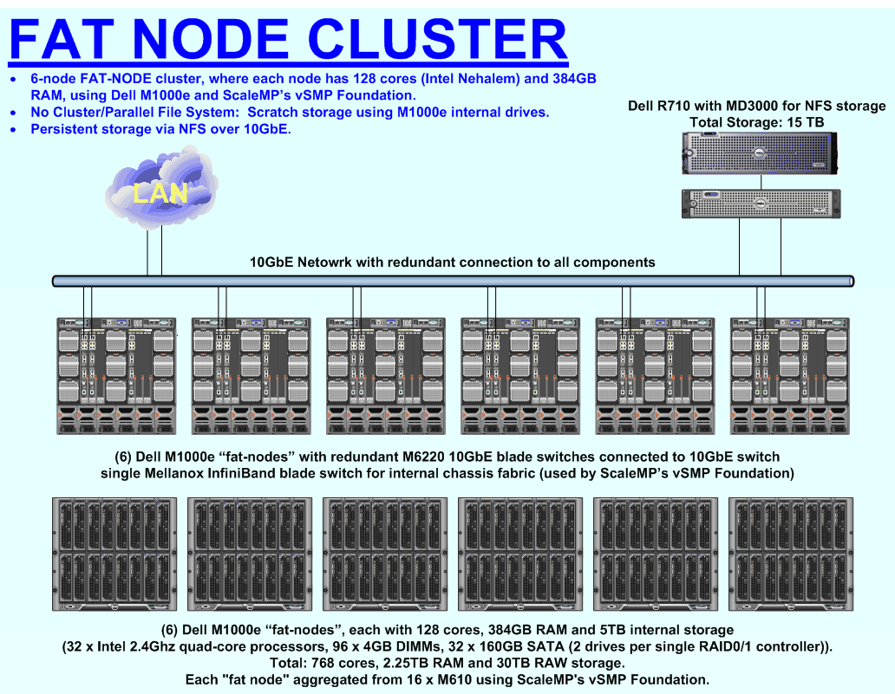
Simplified Cluster - Example

Slide 10






















Customers and Partners
Federal
Educational
Commercial
Supported
Platforms

Slide 11
Target Environments and Applications
Target Environments
Users seeking to simplify cluster complexities
Applications that use large memory footprint (even with one processor)
Applications that need multiple processors and shared memory
Typical end-user applications
Manufacturing
CSM (Computational Structural Mechanics)
ABAQUS/Explicit
ABAQUS/Standard
ANSYS Mechanical
LSTC LS-DYNA
ALTAIR Radioss
CFD (Computational Fluid Dynamics)
FLUENT
ANSYS CFX
STAR-CD
AVL FIRE
Tgrid
Other
inTrace OpenRT
Life Sciences
Gaussian
VASP
AMBER
Schrödinger Jaguar
Schrödinger Glide
NAMD
DOCK
GAMESS
GOLD
mpiBLAST
GROMACS
MOLPRO
OpenEye FRED
OpenEye OMEGA
SCM ADF
HMMER
Energy
Schlumberger ECLIPSE
Paradigm GeoDepth
3DGEO 3DPSDM
Norsar 3D
EDA
Mentor
Cadence
Synopsys
Finance
Wombat
KX
Others
The MathWorks MATLAB
R
Octave
Wolfram MATHEMATICA
ISC STAR-P

Slide 12
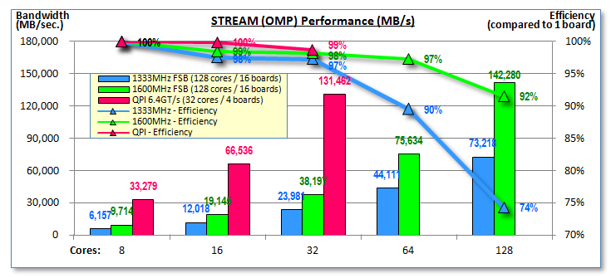
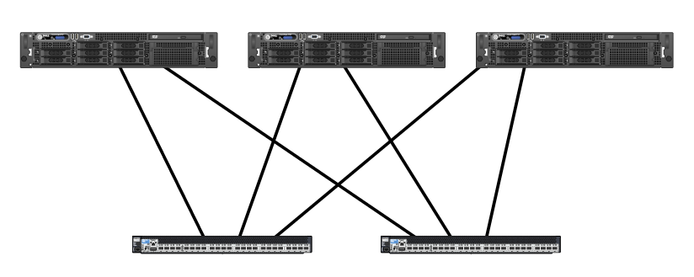
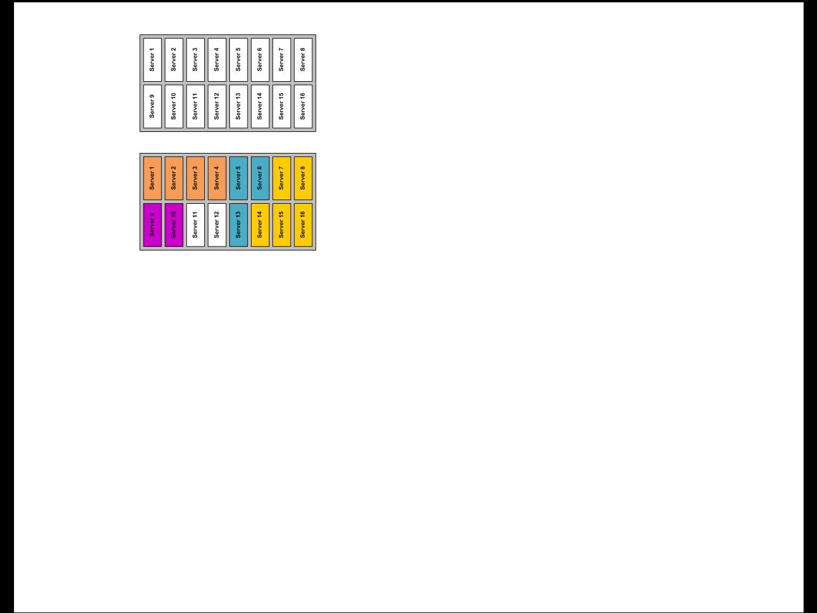
vSMP Foundation 2.0
Support for Intel® Nehalem Processor Family
  First Nehalem solution with more than 2 processors
  Up to 3 times better performance compared to
  Harpertown systems
  Optimized performance with intra-board memory
  placement and QDR InfiniBand
High-availability with dual-rail InfiniBand
  2 InfiniBand switches (dual-rail) in an active-active configuration
  Automatic failover on link errors (cable) or switch failure
  Improved performance with switch load-balancing (both switches used in parallel)
Partitioning
  Hardware-level isolated partitions, each can run
  different OS
  Up to 8 partitions, minimum 2 servers per partition
  Requires add-on license
Emulex LightPulse® Fibre-Channel HBA Support
Server A
Server B
Server C
Automatic failover and load-balancing
InfiniBand Switch 1
InfiniBand Switch 2
Multiple Partitions
Single Partition

Slide 13
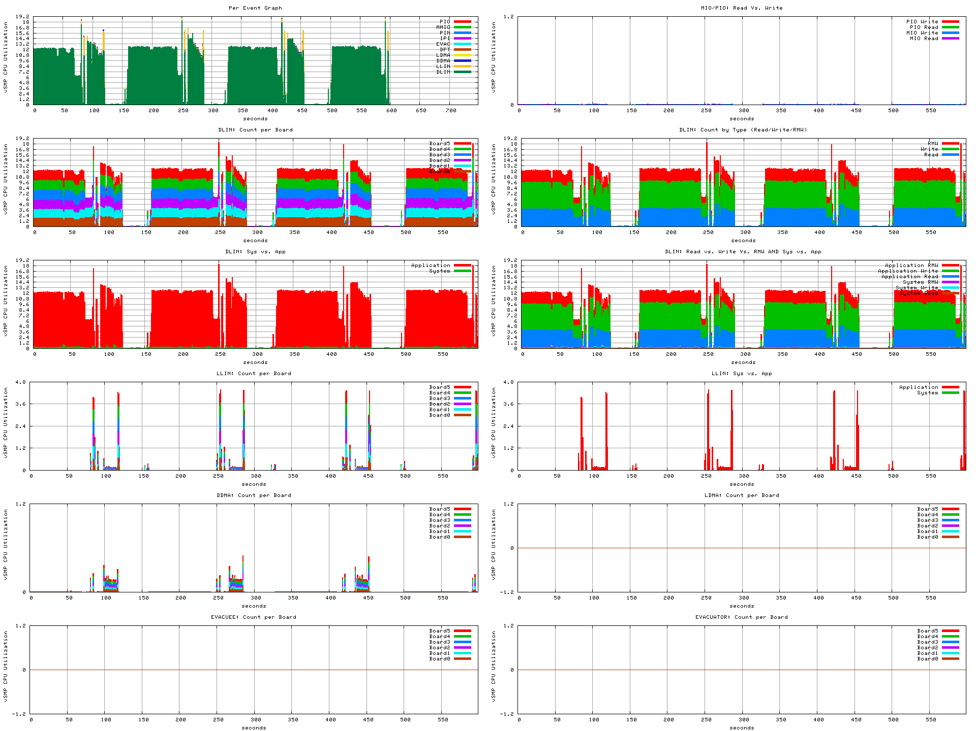
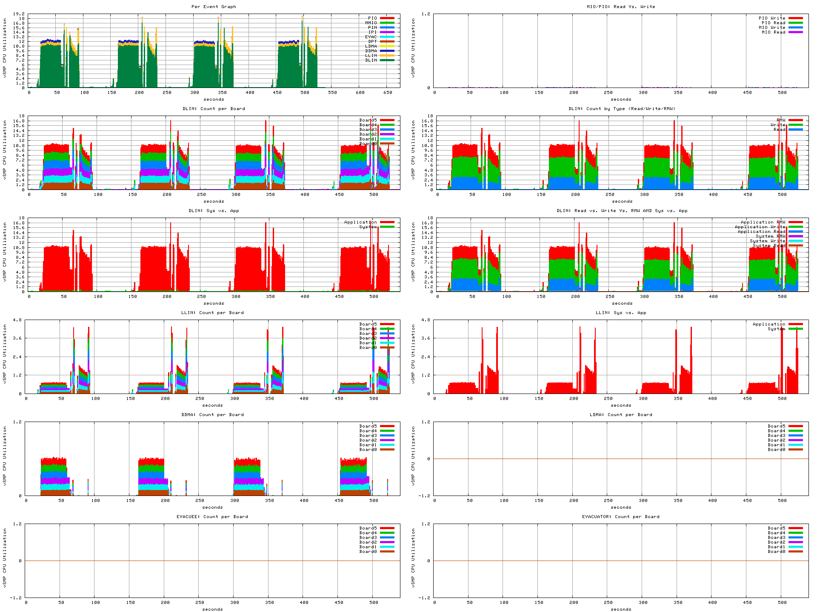
vSMP Foundation 2.0
COMPLETE SYSTEM VIEW - NOW AVAILABLE FOR ACADEMIC INSTITUTES !
Before
After

Slide 14
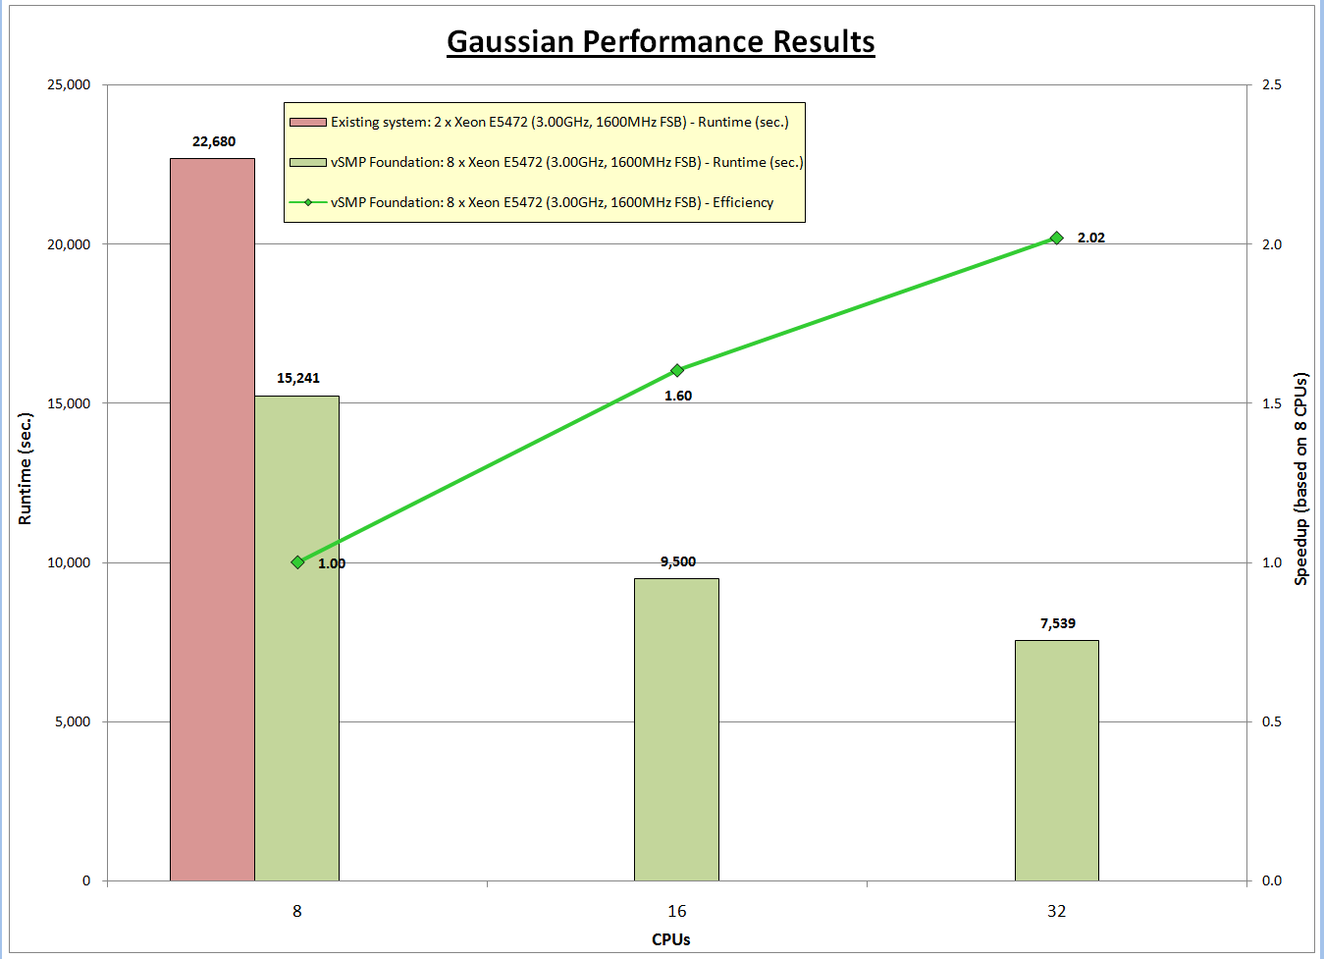
Some Performance Data
GAUSSIAN

Slide 15
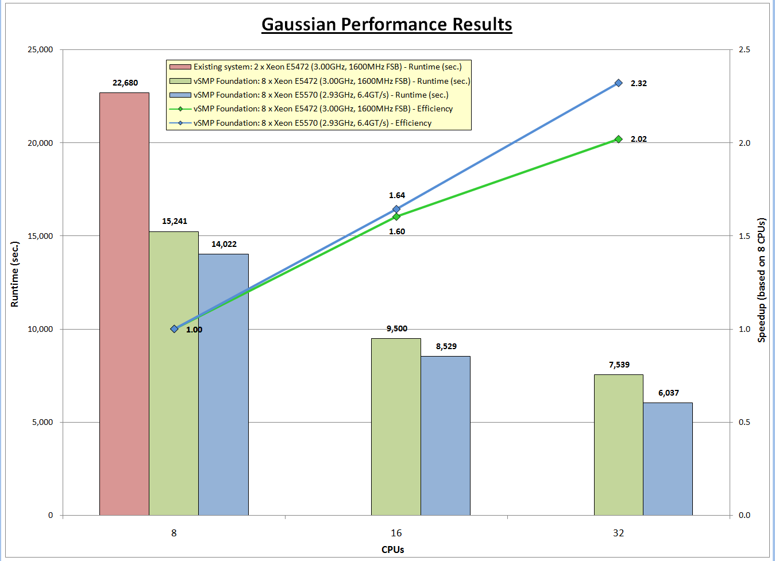
Some Performance Data
GAUSSIAN

Slide 16
vSMP Foundation Performance
STREAM (OMP) - MB/SEC. (HIGHER IS BETTER)
HW Characteristics:
  1333MHz - 32 x Intel XEON E5345 QC (Clovertown), 2.33GHz, 2x4MB L2, 1333MHz; 900/960GB (vSMP Foundation 1.7) (Source: ScaleMP)
  1600MHz - 32 x Intel XEON E5472 QC (Harpertown), 3.00GHz, 2x6MB L2, 1600MHz; 249/288GB (vSMP Foundation 1.7) (Source: ScaleMP)
  QPI 6.4GT/s - 4 x Intel XEON X5570 QC (Nehalem), 2.93GHz, 8MB L3, QPI 6.4; 9/16GB (vSMP Foundation 1.7) (Source: ScaleMP)

Slide 17
vSMP Foundation Performance
SPECint_rate_base2000 - RATE (HIGHER IS BETTER)
Higher is Better
HW Characteristics:
  vSMP Foundation™ (QC-8 core): 2 x Intel XEON 5345 QC (Clovertown), 2.33GHz, 2x4MB L2; 908/960GB (vSMP Foundation 1.7) (Source: ScaleMP)
  vSMP Foundation™ (QC-128 core): 32 x Intel XEON 5345 QC (Clovertown), 2.33GHz, 2x4MB L2; 908/960GB (vSMP Foundation 1.7) (Source: ScaleMP)

Slide 18
vSMP Foundation Performance
SPECint_rate_base2006 - RATE (HIGHER IS BETTER)
HW Characteristics:
  QPI 6.4GT/s - 4 x Intel XEON X5570 QC (Nehalem), 2.93GHz, 8MB L3, QPI 6.4; 9/16GB (vSMP Foundation 1.7) (Source: ScaleMP)

Slide 19
vSMP Foundation Performance
SPECfp_rate_base2000 - RATE (HIGHER IS BETTER)
Higher is Better
HW Characteristics:
  vSMP Foundation™ (QC-8 core): 2 x Intel XEON 5345 QC (Clovertown), 2.33GHz, 2x4MB L2; 908/960GB (vSMP Foundation 1.7) (Source: ScaleMP)
  vSMP Foundation™ (QC-128 core): 32 x Intel XEON 5345 QC (Clovertown), 2.33GHz, 2x4MB L2; 908/960GB (vSMP Foundation 1.7) (Source: ScaleMP)

Slide 20
vSMP Foundation Performance
SPECfp_rate_base2006 - RATE (HIGHER IS BETTER)
HW Characteristics:
  QPI 6.4GT/s - 4 x Intel XEON X5570 QC (Nehalem), 2.93GHz, 8MB L3, QPI 6.4; 9/16GB (vSMP Foundation 1.7) (Source: ScaleMP)

Slide 21
Shai Fultheim
Founder and President
Shai@ScaleMP.com, +1 (408) 480 1612

